Slide 1


Salvatore Baglieri
31/03/2023

Slide 2

Outline
Executive Summary
Introduction
Methodology
Results
Conclusion
Appendix

Slide 3
Executive Summary
Summary of methodologies
Data Collection
Data Wrangling
EDA (Exploratory Data Analysis)
Interactive Visual Analytics
Predictive Analysis
Summary of all results
EDA results
Geospatial analytics
Interactive dashboard
Predictive analysis of classification models

Slide 4
Introduction
Background
SpaceX launches Falcon 9 rockets at a cost of around $62m.
This is considerably cheaper than other providers (which usually cost upwards of $165m), and much of the savings are because SpaceX can land, and then re-use the first stage of the rocket.
If we can make predictions on whether the first stage will land, we can determine the cost of a launch, and use this information to assess whether an alternate company should bid and SpaceX for a rocket launch.
Problem
Train a machine learning model to predict successful Stage 1 recovery.

Slide 5

Section 1

Slide 6
Methodology
Executive Summary
Data collection methodology:
Combined data from SpaceX public API and SpaceX Wikipedia page
Perform data wrangling
Classifying true landings as successful and unsuccessful otherwise
Perform exploratory data analysis (EDA) using visualization and SQL
Perform interactive visual analytics using Folium and Plotly Dash
Perform predictive analysis using classification models
Tuned models using GridSearchCV

Slide 7
Data Collection
Data collection process involved a combination of API requests from Space X public API and web scraping data from a table in Space X’s Wikipedia entry.
The next slide will show the flowchart of data collection from API and the one after will show the flowchart of data collection from webscraping.

Slide 8
Data Collection – SpaceX API
Using the SpaceX API to retrieve data about launches, including information about the rocket used, payload delivered, launch specifications, landing specifications, and landing outcome.
GitHub URL
API requests from Space X
JSON file + Lists (Launch Site, Booster Version, Payload Data)
Json_normalize to Pandas DataFrame data from JSON
Dictionary relevant data
Cast dictionary to a Pandas DataFrame
Filter data to only include Falcon 9 launches
Imputate missing PayloadMass values with mean

Slide 9
Data Collection - Scraping
Using the SpaceX API to retrieve data about launches, including information about the rocket used, payload delivered, launch specifications, landing specifications, and landing outcome.
GitHub URL
Request Wikipedia html
BeautifulSoup html5lib Parser
Find launch info html table
Create dictionary
Iterate through table cells to extract data to dictionary
Cast dictionary to DataFrame

Slide 10
Data Wrangling
The SpaceX dataset contains several Space X launch facilities, and each location is in the LaunchSite column.
Each launch aims to a dedicated orbit, and some of the common orbit types are shown in the figure below. The orbit type is in the Orbit column.
The landing outcome is shown in the Outcome column:
True Ocean – the mission outcome was successfully landed to a specific region of the ocean
False Ocean – the mission outcome was unsuccessfully landed to a specific region of the ocean.
True RTLS – the mission outcome was successfully landed to a ground pad
False RTLS – the mission outcome was unsuccessfully landed to a ground pad.
True ASDS – the mission outcome was successfully landed to a drone ship
False ASDS – the mission outcome was unsuccessfully landed to a drone ship.
None ASDS and None None – these represent a failure to land.
GitHub URL
Create a training label with landing outcomes where successful = 1 & failure = 0
Outcome column has two components: ‘Mission Outcome’ ‘Landing Location’
New training label column ‘class’ with a value of 1 if ‘Mission Outcome’ is True and 0 otherwise

Slide 11
EDA with Data Visualization
Exploratory Data Analysis performed on variables Flight Number, Payload Mass, Launch Site, Orbit, Class and Year.
GitHub URL
SCATTER PLOT
BAR CHART
LINE CHART
Flight Number and Launch Site
Payload and Launch Site
Orbit Type and Flight Number
Payload and Orbit Type
Scatter charts were produced to visualizethe relationships between:
Scatter charts are useful to observe relationships, or correlations, between two numeric variables.
A bar chart was produced to visualize the relationship between:
Success Rate and Orbit Type
Bar charts are used to compare a numerical value to a categorical variable. Horizontal or vertical bar charts can be used, depending on the size of the data.
Line charts were produced to visualize the relationships between:
Success Rate and Year (i.e. the launch success yearly trend)
Line charts contain numerical values on both axes, and are generally used t show the change of a variable over time.

Slide 12
EDA with SQL
The SQL queries performed on the data set were used to:
Display the names of the unique launch sites in the space mission
Display 5 records where launch sites begin with the string ‘CCA’
Display the total payload mass carried by boosters launched by NASA (CRS)
Display the average payload mass carried by booster version F9 v1.1
List the date when the first successful landing outcome on a ground pad was achieved
List the names of the boosters which had success on a drone ship and a payload mass between 4000 and 6000 kg
List the total number of successful and failed mission outcomes
List the names of the booster versions which have carried the maximum payload mass
List the failed landing outcomes on drone ships, their booster versions, and launch site names for 2015
Rank the count of landing outcomes (such as Failure (drone ship) or Success (ground pad)) between the date 2010-06-04 and 2017-03-20, in descending order
GitHub URL

Slide 13
Build an Interactive Map with Folium
Folium maps mark Launch Sites, successful and unsuccessful landings, and a proximity example to key locations: Railway, Highway, Coast, and City.
This allows us to understand why launch sites may be located where they are. Also visualizes successful landings relative to location.
GitHub URL

Slide 14
Build a Dashboard with Plotly Dash
Dashboard includes a pie chart and a scatter plot.
Pie chart can be selected to show distribution of successful landings across all launch sites and can be selected to show individual launch site success rates.
Scatter plot takes two inputs: All sites or individual site and payload mass on a slider between 0 and 10000 kg.
The pie chart is used to visualize launch site success rate.
The scatter plot can help us see how success varies across launch sites, payload mass, and booster version category.
GitHub URL

Slide 15
Predictive Analysis (Classification)
The following steps were taking to develop, evaluate, and find the best performing classification model
GitHub URL
Split label column ‘Class’ from dataset
Fit and Transform Features using Standard Scaler
Train_test_split data
GridSearchCV (cv=10) to find optimal parameters
Use GridSearchCV on LogReg, SVM, Decision Tree, and KNN models
Score models on split test set
Confusion Matrix for all models
Barplot to compare scores of models

Slide 16
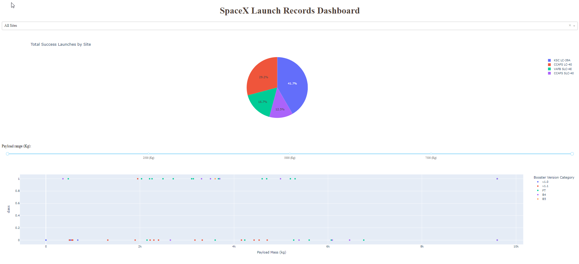
Results

Slide 17

Section 2

Slide 18
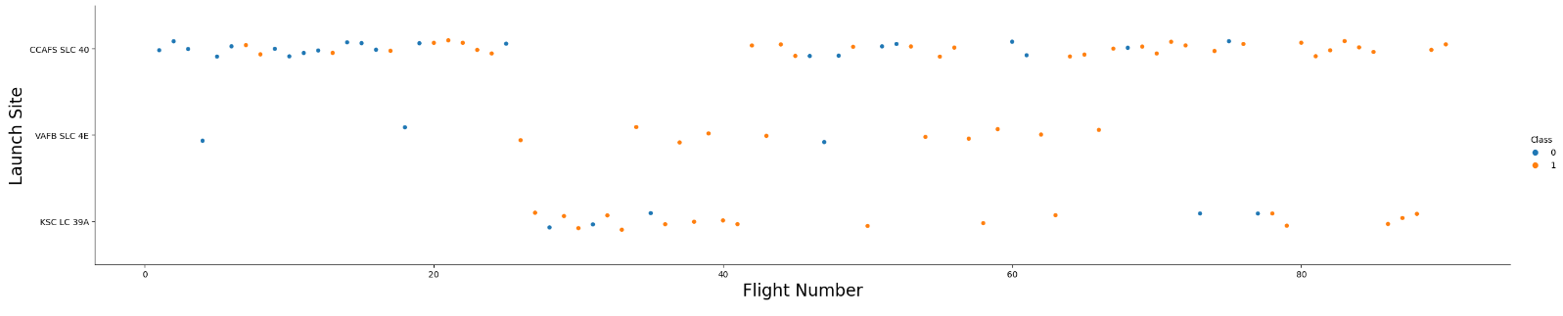
Flight Number vs. Launch Site
Graphic suggests an increase in success rate over time (indicated in Flight Number). Likely a big breakthrough around flight 20 which significantly increased success rate. CCAFS appears to be the main launch site as it has the most volume.

Slide 19
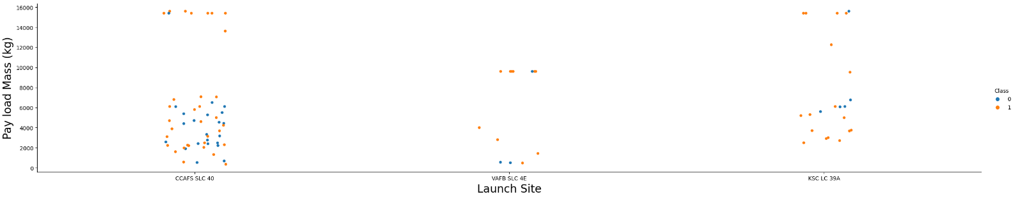
Payload vs. Launch Site
Payload mass appears to fall mostly between 0-6000 kg. Different launch sites also seem to use different payload mass.

Slide 20
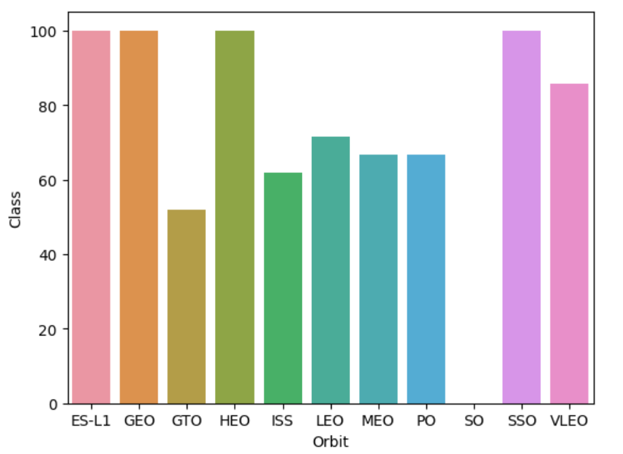
Success Rate vs. Orbit Type
The bar chart of Success Rate vs. Orbit Type shows that the following orbits have the highest (100%) success rate:
ES-L1 (Earth-Sun First Lagrangian Point)
GEO (Geostationary Orbit)
HEO (High Earth Orbit)
SSO (Sun-synchronous Orbit)
The orbit with the lowest (0%) success rate is:
SO (Heliocentric Orbit)

Slide 21
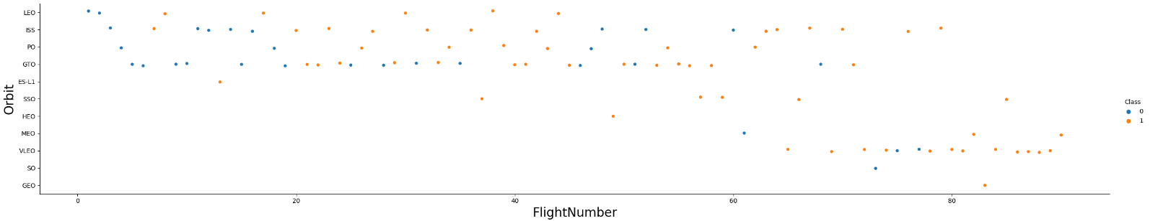
Flight Number vs. Orbit Type
Launch Orbit preferences changed over Flight Number. Launch Outcome seems to correlate with this preference.
SpaceX started with LEO orbits which saw moderate success LEO and returned to VLEO in recent launches SpaceX appears to perform better in lower orbits or Sun-synchronous orbits

Slide 22
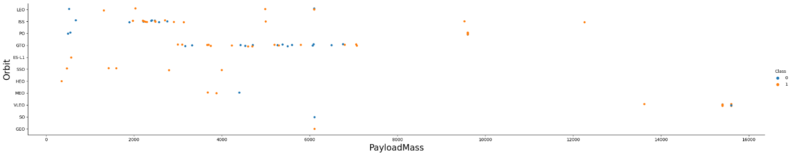
Payload vs. Orbit Type
Payload mass seems to correlate with orbit
LEO and SSO seem to have relatively low payload mass
The other most successful orbit VLEO only has payload mass values in the higher end of the range

Slide 23
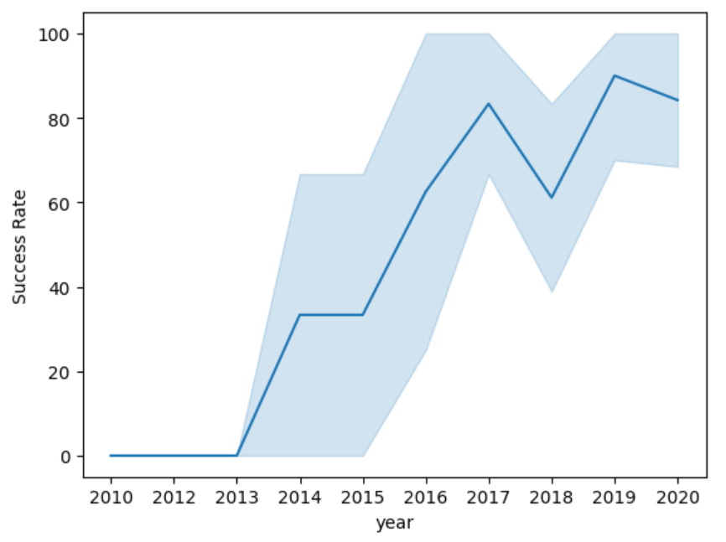
Launch Success Yearly Trend
The line chart of yearly average success rate shows that:
Between 2010 and 2013, all landings were unsuccessful (as the success rate is 0).
After 2013, the success rate generally increased, despite small dips in 2018 and 2020.
After 2016, there was always a greater than 50% chance of success.

Slide 24
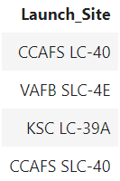
All Launch Site Names
The word UNIQUE returns only unique values from the LAUNCH_SITE column of the SPACEXTBL table.

Slide 25
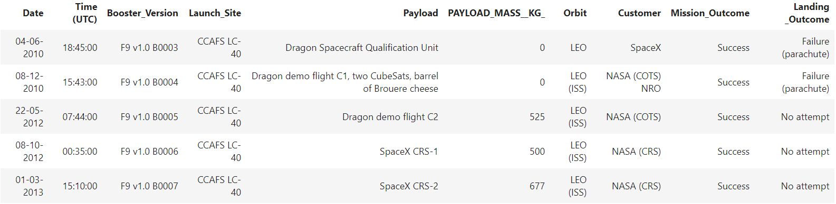
Launch Site Names Begin with 'CCA'
LIMIT 5 fetches only 5 records, and the LIKE keyword is used with the wild card ‘CCA%’ to retrieve string values beginning with ‘CCA’.

Slide 26
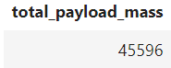
Total Payload Mass
The SUM keyword is used to calculate the total of the LAUNCH column, and the SUM keyword (and the associated condition) filters the results to only boosters from NASA (CRS).

Slide 27
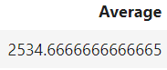
Average Payload Mass by F9 v1.1
The AVG keyword is used to calculate the average of the PAYLOAD_MASS__KG column, and the WHERE keyword (and the associated condition) filters the results to only the F9 v1.1 booster version.

Slide 28
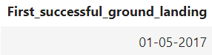
First Successful Ground Landing Date
The MIN keyword is used to calculate the minimum of the DATE column, i.e. the first date, and the WHERE keyword (and the associated condition) filters the results to only the successful ground pad landings.

Slide 29
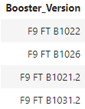
Successful Drone Ship Landing with Payload between 4000 and 6000
The WHERE keyword is used to filter the results to include only those that satisfy both conditions in the brackets (as the AND keyword is also used). The BETWEEN keyword allows for 4000 < x < 6000 values to be selected.

Slide 30
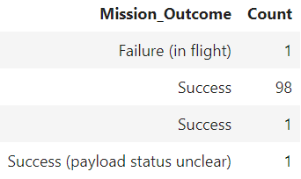
Total Number of Successful and Failure Mission Outcomes
The COUNT keyword is used to calculate the total number of mission outcomes, and the GROUPBY keyword is also used to group these results by the type of mission outcome.

Slide 31
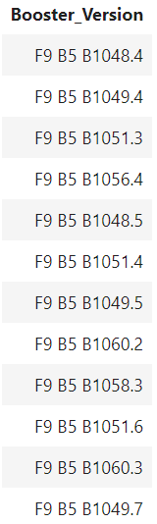
Boosters Carried Maximum Payload
A subquery is used here. The SELECT statement within the brackets finds the maximum payload, and this value is used in the WHERE condition. The DISTINCT keyword is then used to retrieve only distinct /unique booster versions.

Slide 32
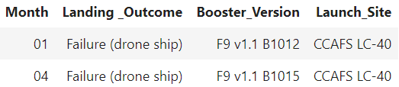
2015 Launch Records
The WHERE keyword is used to filter the results for only failed landing outcomes, AND only for the year of 2015.

Slide 33
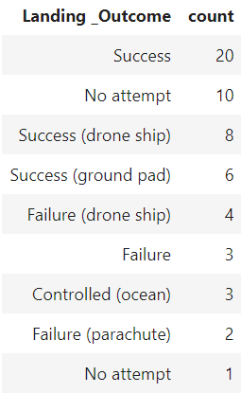
Rank Landing Outcomes Between 2010-06-04 and 2017-03-20
The WHERE keyword is used with the BETWEEN keyword to filter the results to dates only within those specified. The results are then grouped and ordered, using the keywords GROUP BY and ORDER BY, respectively, where DESC is used to specify the descending order.

Slide 34

Section 3

Slide 35
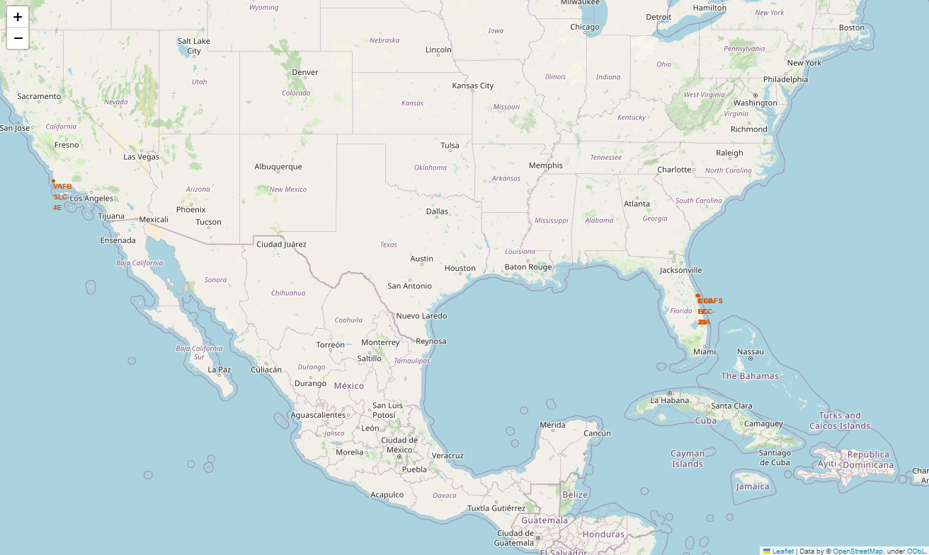
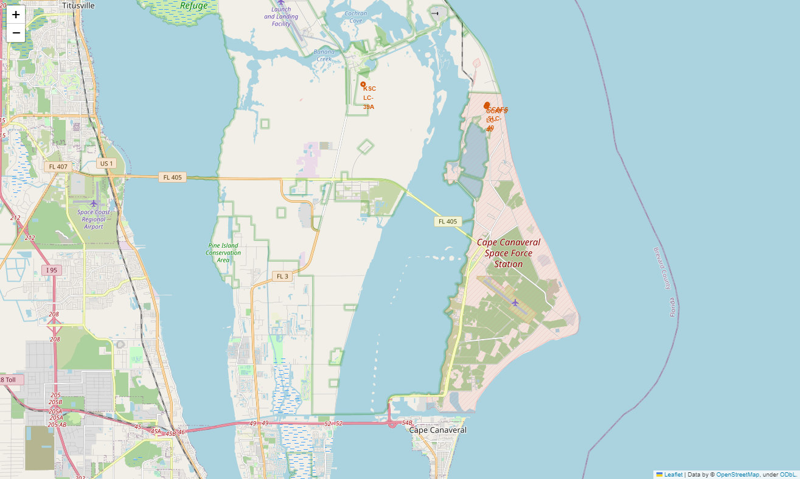
All launch sites on map
All SpaceX launch sites are on coasts of the United States of America, specifically Florida and California.

Slide 36
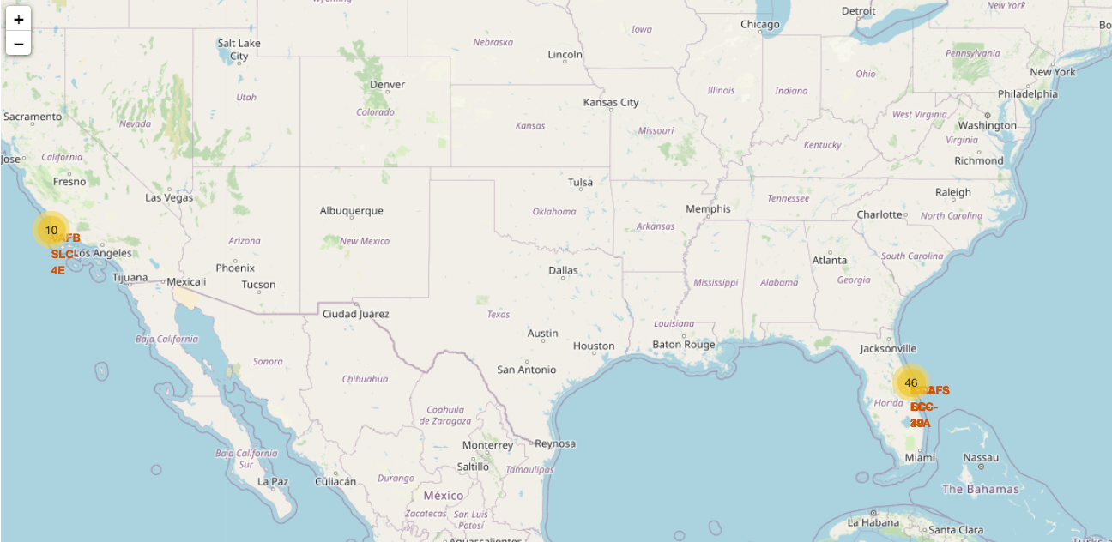
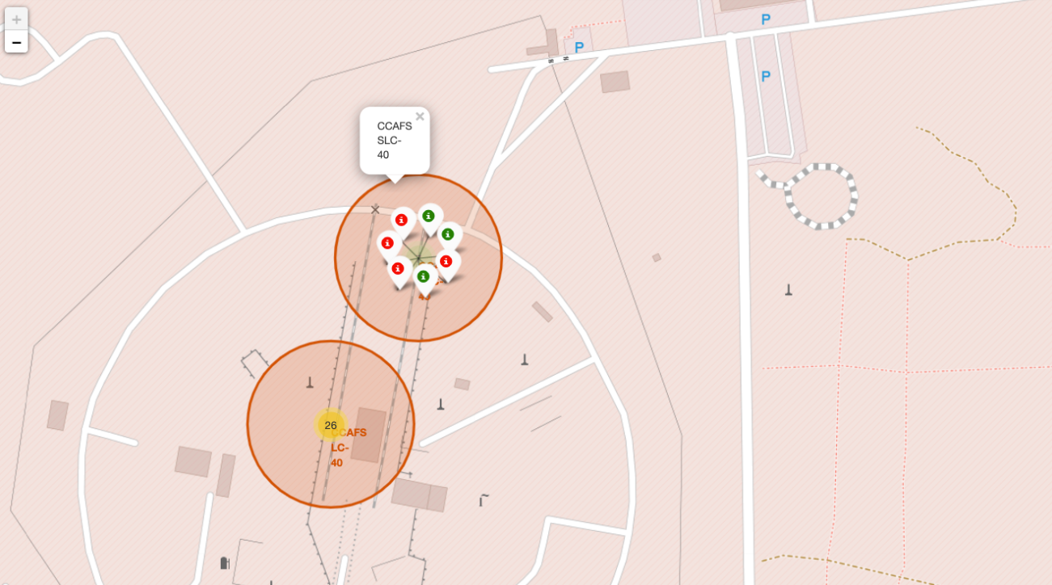
Success/Failed launches for each site
Launches have been grouped into clusters, and annotated with green icons for successful launches, and red icons for failed launches.

Slide 37
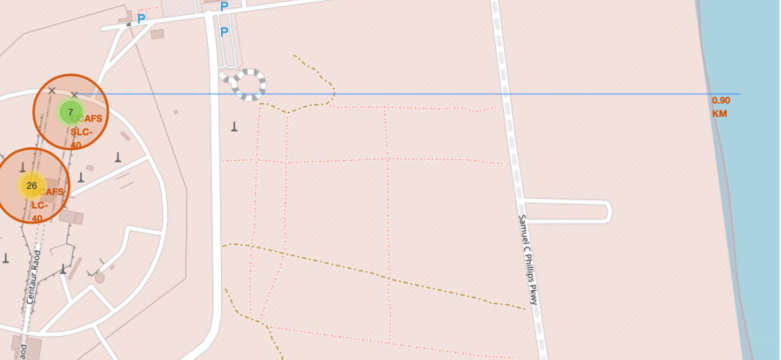
Proximity of launch sites to other points of interest
Using the CCAFS SLC-40 launch site as an example site, we can understand more about the placement of launch sites.

Slide 38

Section 4

Slide 39
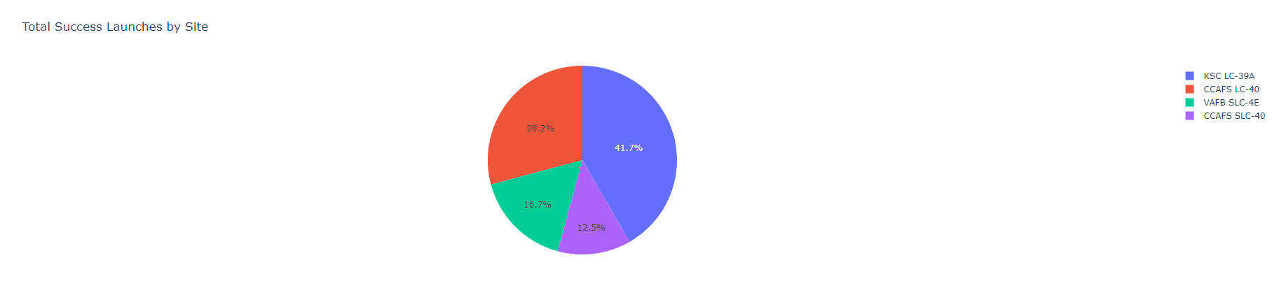
Launch success count for all sites
The launch site KSC LC-39 A had the most successful launches, with 41.7% of the total successful launches.

Slide 40
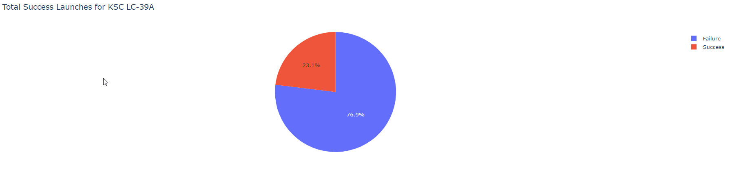
Highest success rate launch sites
The launch site KSC LC-39 A also had the highest rate of successful launches, with a 76.9% success rate.

Slide 41
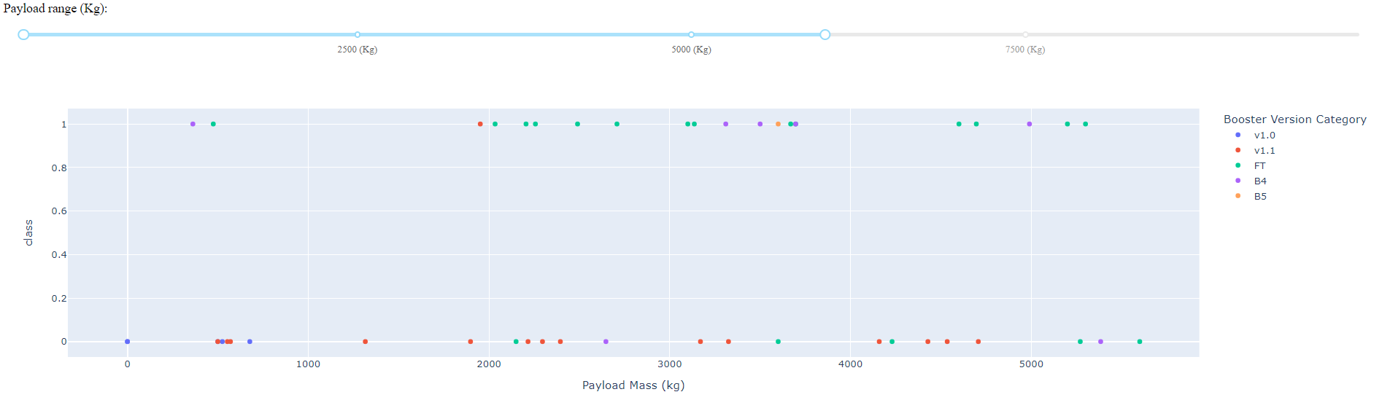
Launch outcome scatter plot for all sites
Plotly dashboard has a Payload range selector. However, this is set from 0-10000 instead of the max Payload of 15600. Class indicates 1 for successful landing and 0 for failure. Scatter plot also accounts for booster version category in color and number of launches in point size. In this particular range of 0-6000, interestingly there are two failed landings with payloads of zero kg.

Slide 42

Section 5

Slide 43
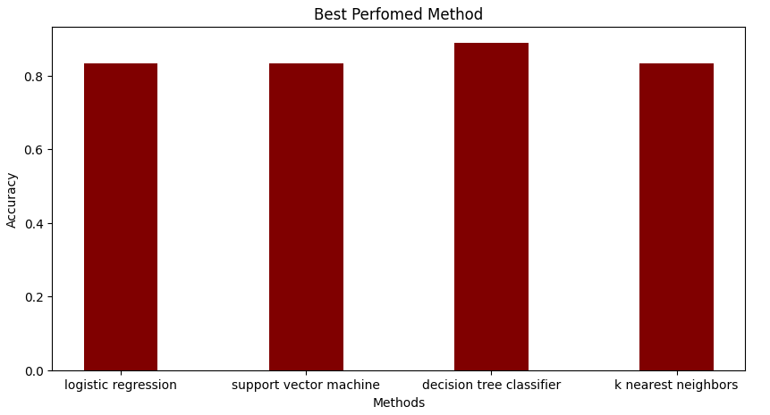
Classification Accuracy
Plotting the Accuracy Score and Best Score for each classification algorithm produces the following result: The Decision Tree model has the highest classification accuracy

Slide 44
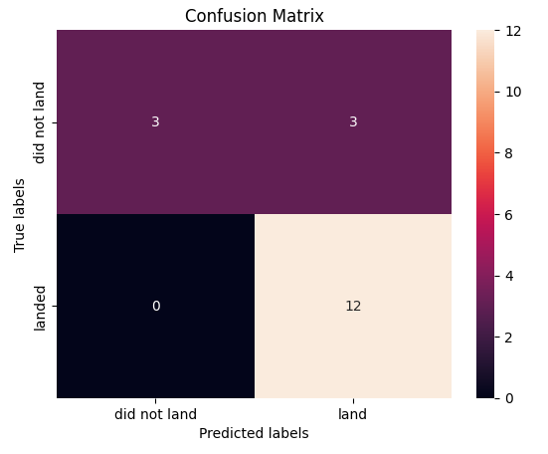
Confusion Matrix
As shown previously, best performing classification model is the Decision Tree.
This is explained by the confusion matrix, which shows only 1 out of 18 total results classified incorrectly (a false positive, shown in the top-right corner).
The other 17 results are correctly classified (5 did not land, 12 did land).

Slide 45
Conclusions
As the number of flights increases, the rate of success at a launch site increases, with most early flights being unsuccessful. I.e. with more experience, the success rate increases.
Between 2010 and 2013, all landings were unsuccessful (as the success rate is 0).
After 2013, the success rate generally increased, despite small dips in 2018 and 2020.
After 2016, there was always a greater than 50% chance of success.
Orbit types ES-L1, GEO, HEO, and SSO, have the highest (100%) success rate.
The 100% success rate of GEO, HEO, and ES-L1 orbits can be explained by only having 1 flight into the respective orbits.
The 100% success rate in SSO is more impressive, with 5 successful flights.
The orbit types PO, ISS, and LEO, have more success with heavy payloads:
VLEO (Very Low Earth Orbit) launches are associated with heavier payloads, which makes intuitive sense.
The launch site KSC LC-39 Ahad the most successful launches, with 41.7% of the total successful launches, and also the highest rate of successful launches, with a 76.9% success rate.
The success for massive payloads (over 4000kg) is lower than that for low payloads.
The best performing classification model is the Decision Tree model.

Slide 46

Appendix
GitHub repository URL

Slide 47


